Slide 1
Python Exercises
CSC1003

Slide 2
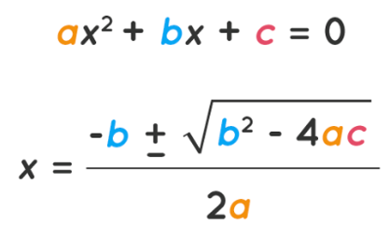
Quadratic Formula
The quadratic formula is:
Write a Python program that reads the value of a, b, c. Then, if a real solution exist, output the round down of solutions (always output 2 solutions even if they are the same, and output the larger solution first); else, output “No real solution”.
OJ Link: https://oj.cuhk.edu.cn/d/csc1003_2025_fall/p/P1024

Slide 3
Divisible
Try “Divisible” again, but in Python.
OJ Link: https://oj.cuhk.edu.cn/d/csc1003_2025_fall/p/P1025

Slide 4
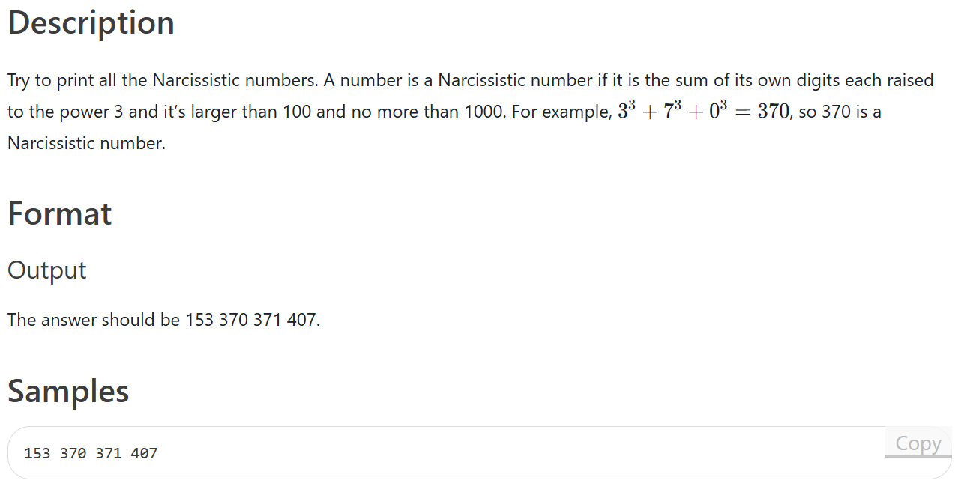
Narcissistic numbers (Python)
OJ Link: https://oj.cuhk.edu.cn/d/csc1003_2025_fall/p/P1026

Slide 5
Dictionary (Python)
Get familiar with python dictionary with the following program:
Create a tool that can return the corresponding name, school and major with the input of student number. (You can store these values in a nested dictionary)
You can generate some fixed arbitrary data for the tool.
Example: for input 122504897, the program may return (Mike, SDS, STAT).
You can add more features, such as return a list of student information whose student numbers are within a certain range.

Slide 6
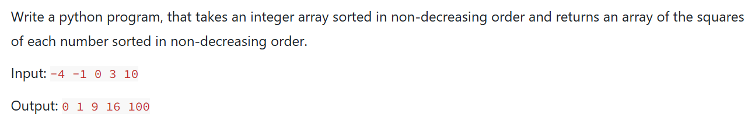
Square (Python)
OJ Link: https://oj.cuhk.edu.cn/d/csc1003_2025_fall/p/P1029

